Slide 1
BPS ANALYTICS
RECOMMENDATION ENGINE
Roadmap & Framework
BPS RECOMMENDATION ENGINE

Slide 2
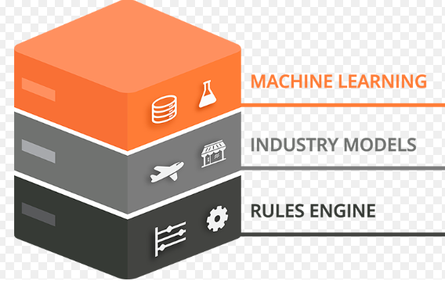


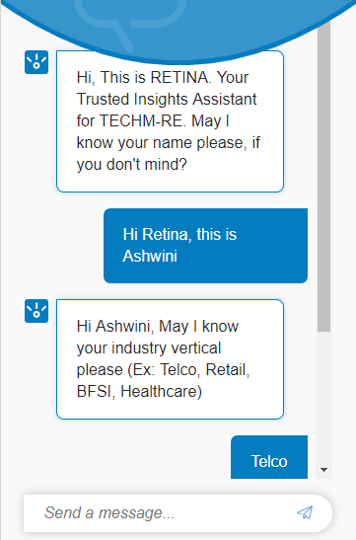











BPS-RE : Recommendation Engine
Customer Profile
Understand Business needs
Smart Visualization
Suggest best interventions
RE (Predictive + Prescriptive) (AI Engine)
NPS
Customer Churn
Cross-Sell /
Up-Sell
FCR
Remediation
Retention Offers
Recommendation
CONSULTING
ANALYTICS & ROBOTICS
AUTOMATION (CLOUD + RPA + NLP + AI BOTs + DEVOPS + CI/CD)

Slide 3




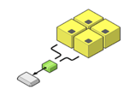

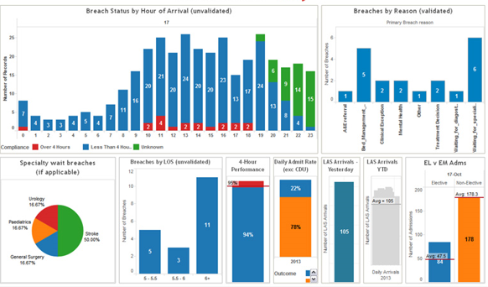


How RE works
Data Ingestion from:
RDBMS
Big Data Sources (Cloudera)
MongoDB
CSV Files / Flat Files
Churn
Service Desk
Telecom
Customer Experience
FCR
Retail
Supply Chain
BFSI
Finance & Accounting
Health & Life Sciences
Interact Over Web, Desktop, Smartphone
NPS
Industry Analytics
Cross-Sell / Up-Sell
Analytics
Engine
Recommended
Key Risks drivers / Key Metrics
Feature
Engineering
Model
Building on
Multiple Platform
(R, Python, AWS)
Model
Comparison
Smart Visualization
Model Automation – Self Learning

Slide 4
Demo Link

Slide 5
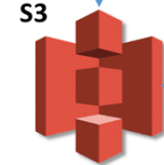
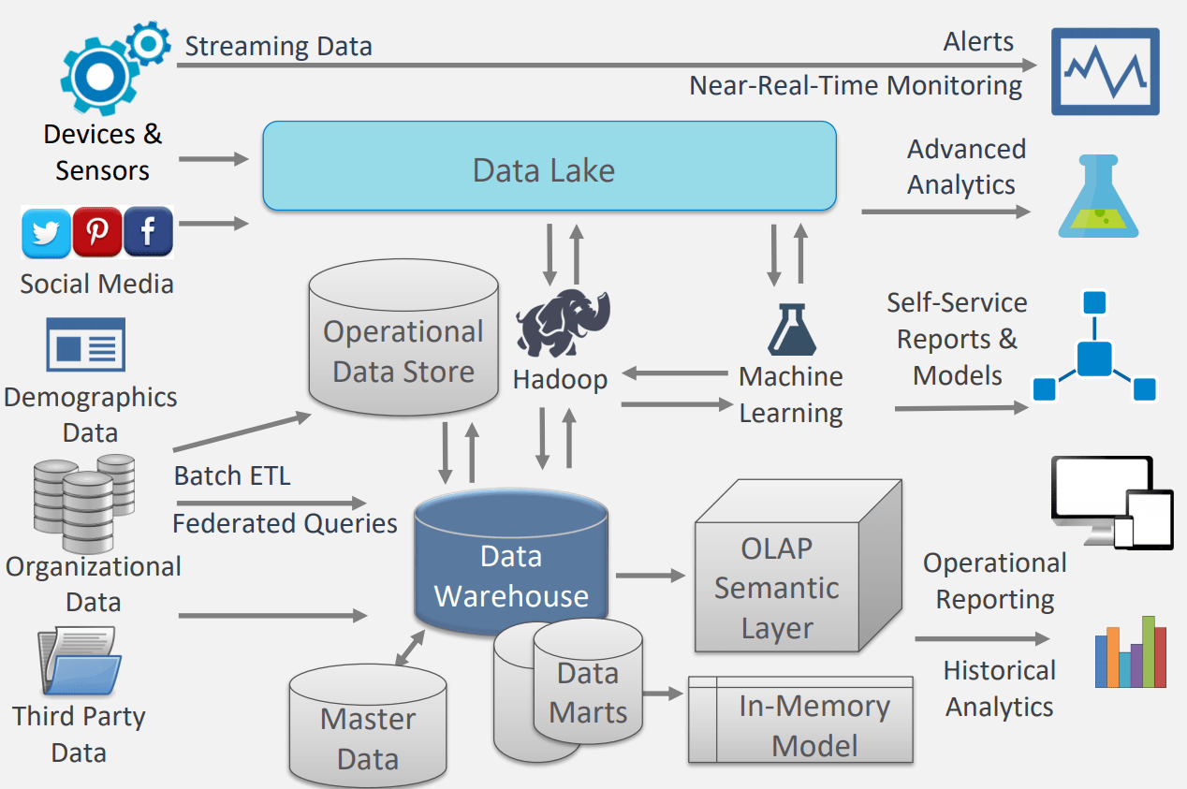


















BPS-RE: ARCHITECTURE
Web based app (Powered by ChatBot/VoiceBot Assistant)
CLIENT DATA SOURCES
** RE (AI CORE ENGINE + DATA LAKE )
SMART VISUALIZATION
Calls
Chat support
TONE ANALYSER
Dialler Data
Chat Data
BATCH LOAD
DAILY LOAD
REAL-TIME
Raw data
Enriched data
Model + Prediction
Recommended KPIs, Reports and Dashboards
Service Desk
Usage
Service
Usage Data
Predictive
and
Prescriptive Analytics Results
ETL
Amazon Glue
Billing
Agent 360
Billing Data
Agent Performance
AI CORE ENGINE
** RE data lake and core engine is displayed for AWS cloud indicatively.
Similarly, it will be offered for other Cloud/ On-premise Tech stacks
SageMaker/ R / Python/ Scala
Customer
PARTNER SOLUTIONS INTEGRATION
Customer Data
AUTOMATION SOLUTIONS (RPA + DEVOPS)
ON CLOUD
+
ON PREMISE

Slide 6
BPS-RE: MVP Roadmap
Identify customers, focus areas and 1-2 use cases for MVP
Identify data and infra requirements
Development stack and Partner tools
Formulate business rules
Back-end workflow & design
Frontend workflow & UX/ UI design
Chabot workflow & design
Access/ Technology setup
Identify data sources and collect data
Build application front-end and Chabot
Build data pipeline
Build RE engine
Integrate partner tools
Integrate front-end and back-end
Build deployment scripts
Deploy on pre-prod setup
Test cases
Functional test and validate
Performance test
Data integrity & security test
Re-configure
Re-Test
Deploy in Self-service model
UAT
Re-configure with stakeholder inputs
Re-deploy
Pricing/ RoI models
Demos/ Videos for Rainmakers
Roadshows/ Tech summits/ Client workshops
Digital Marketing
Roadmap Snapshot
DURATION
~4-5 Months including GTM
Phase 3
DEPLOY
2 weeks
Phase 4
GTM & GO-LIVE
(4-6 weeks)
PEOPLE
4-5 Resources
Phase 2
PRE-PROD & TEST
2 weeks
Phase 0
ANALYSE & DESIGN
4 weeks
Phase 1
BUILD & INTEGRATE
6-8 weeks

